Slide 1
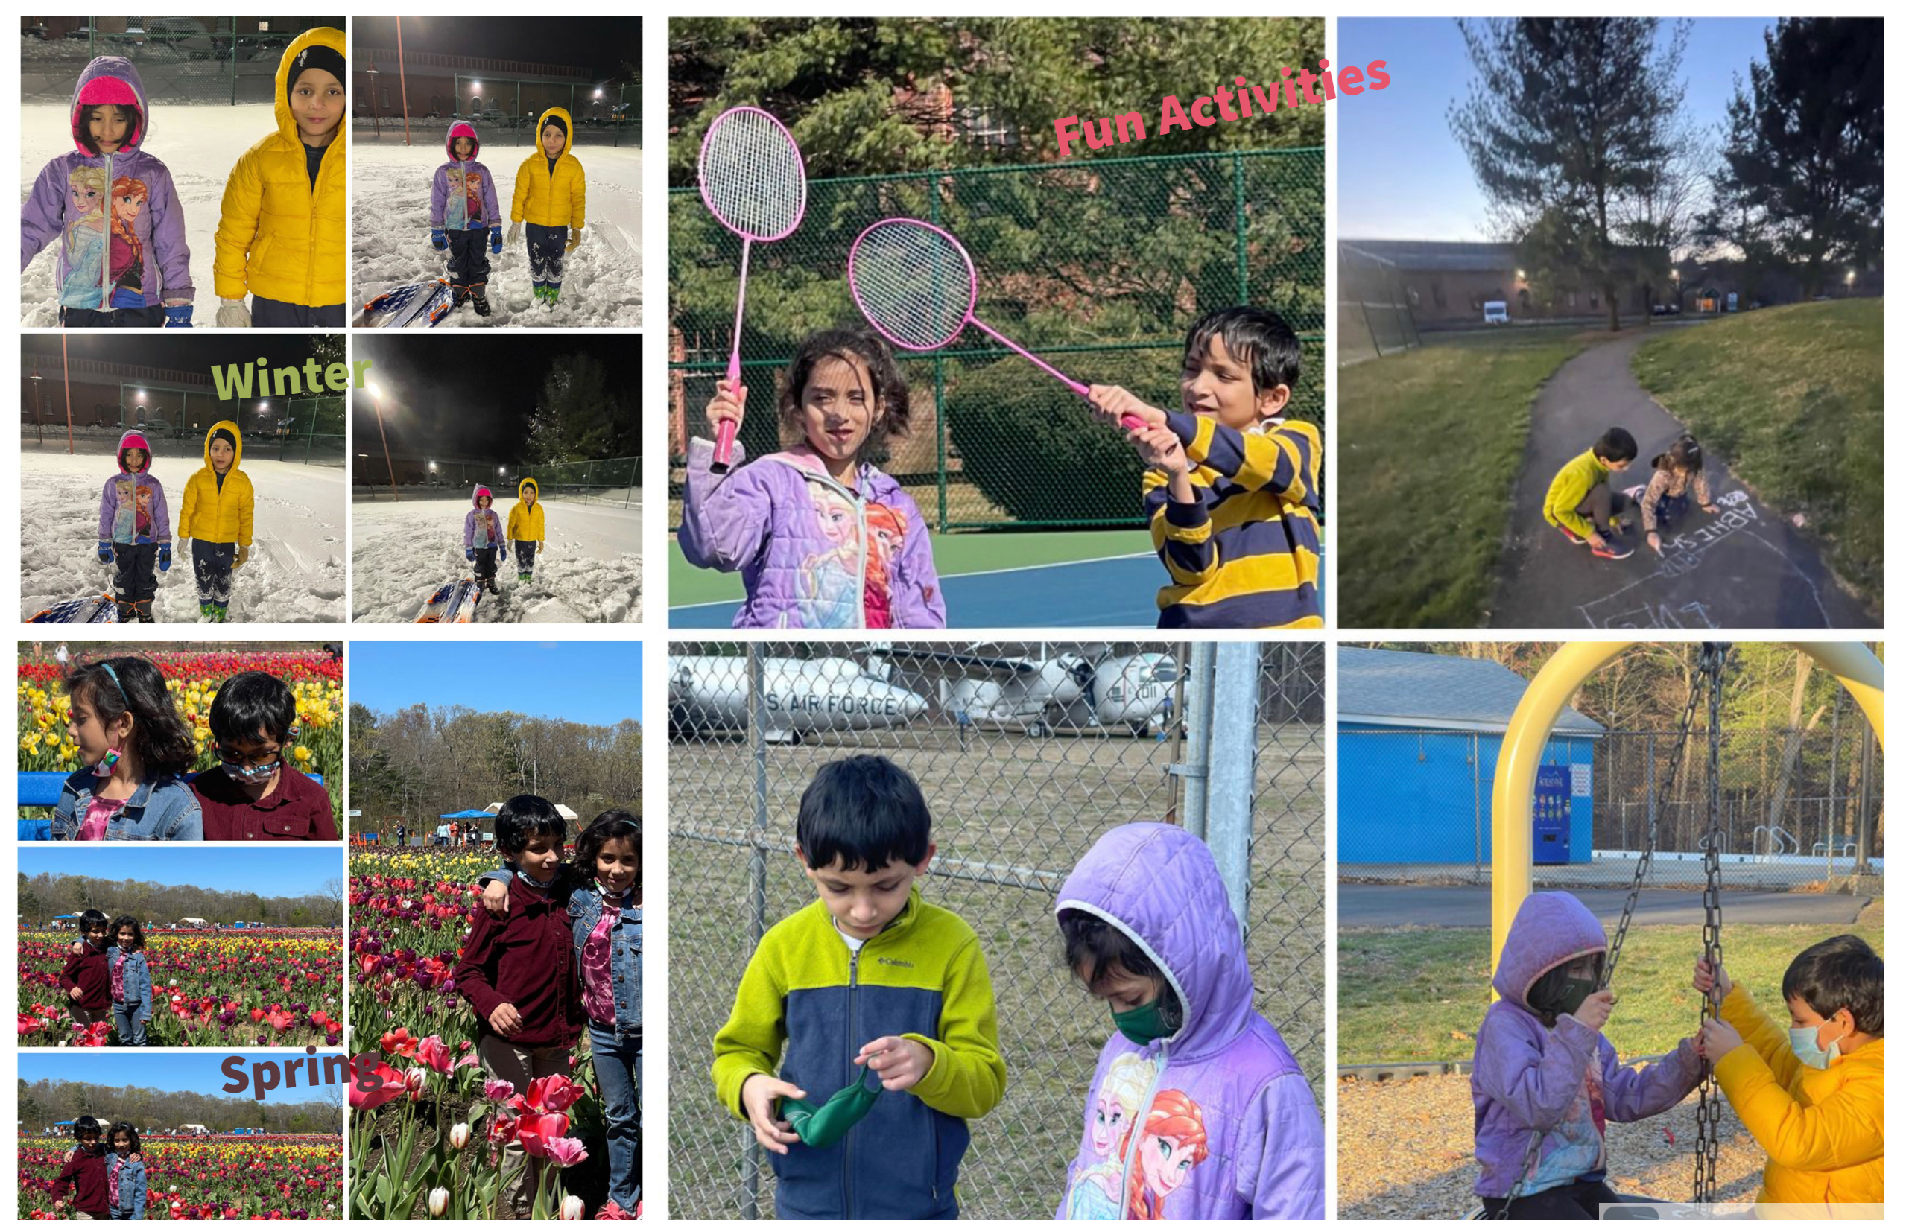
Twins Outdoor Activities

Slide 2
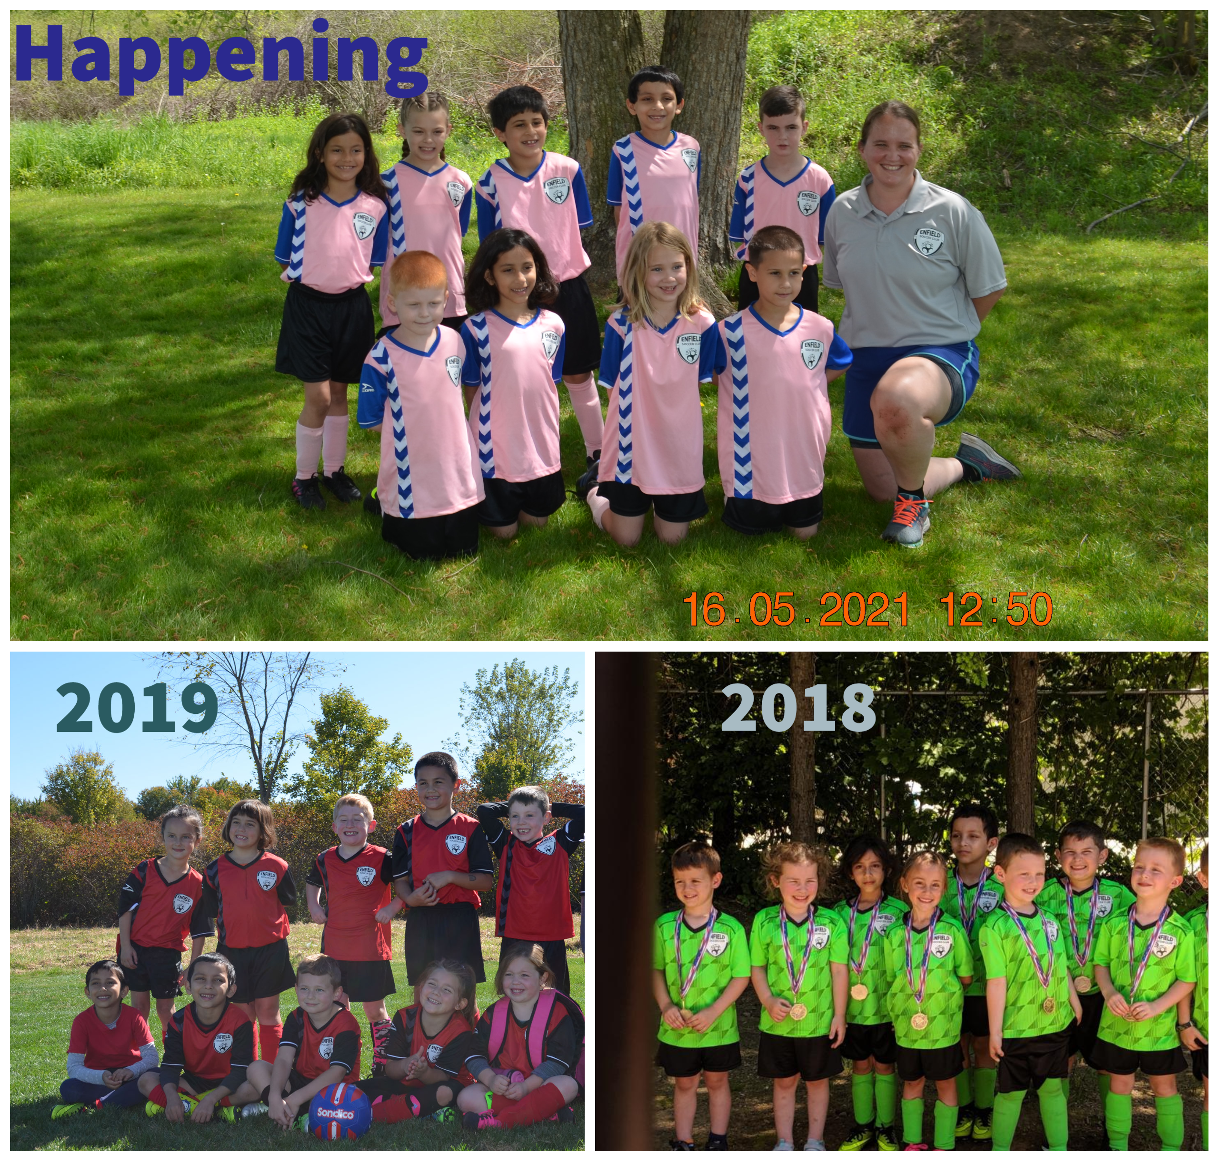
Twins love Soccer

Slide 3
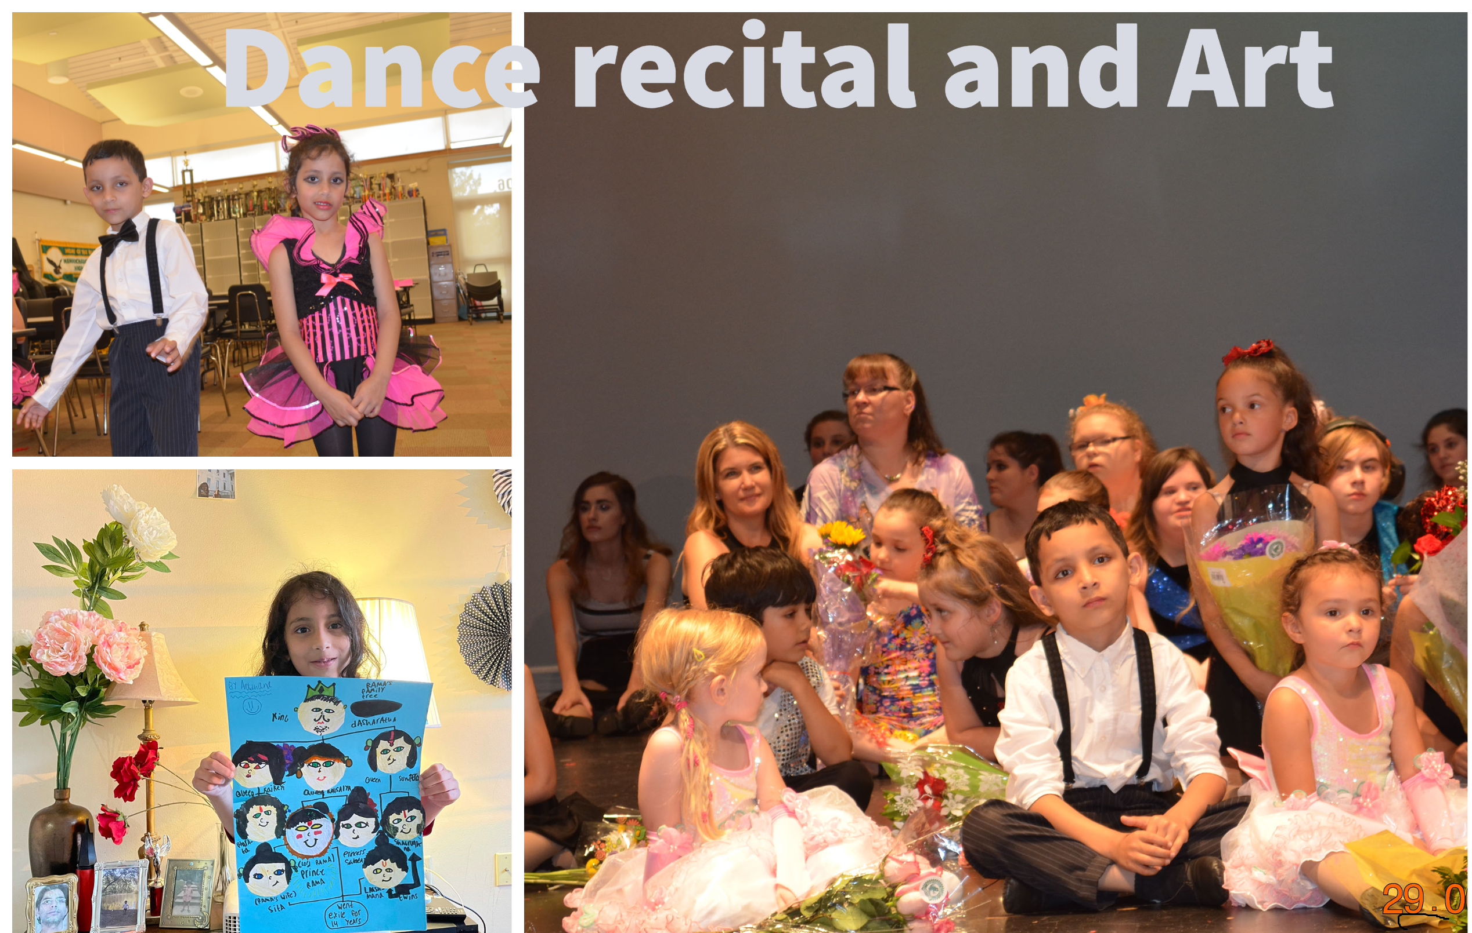
Art and Dance

